Slide 1

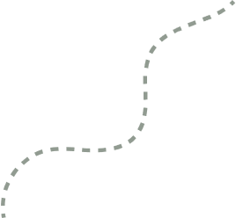

Data Spark
By Tech Triumphs

Slide 2

I am
Bhaumik Yadav
Inspiring fresh minds to harness data, decode patterns, and shape meaningful narratives through analytics and research.

Slide 3
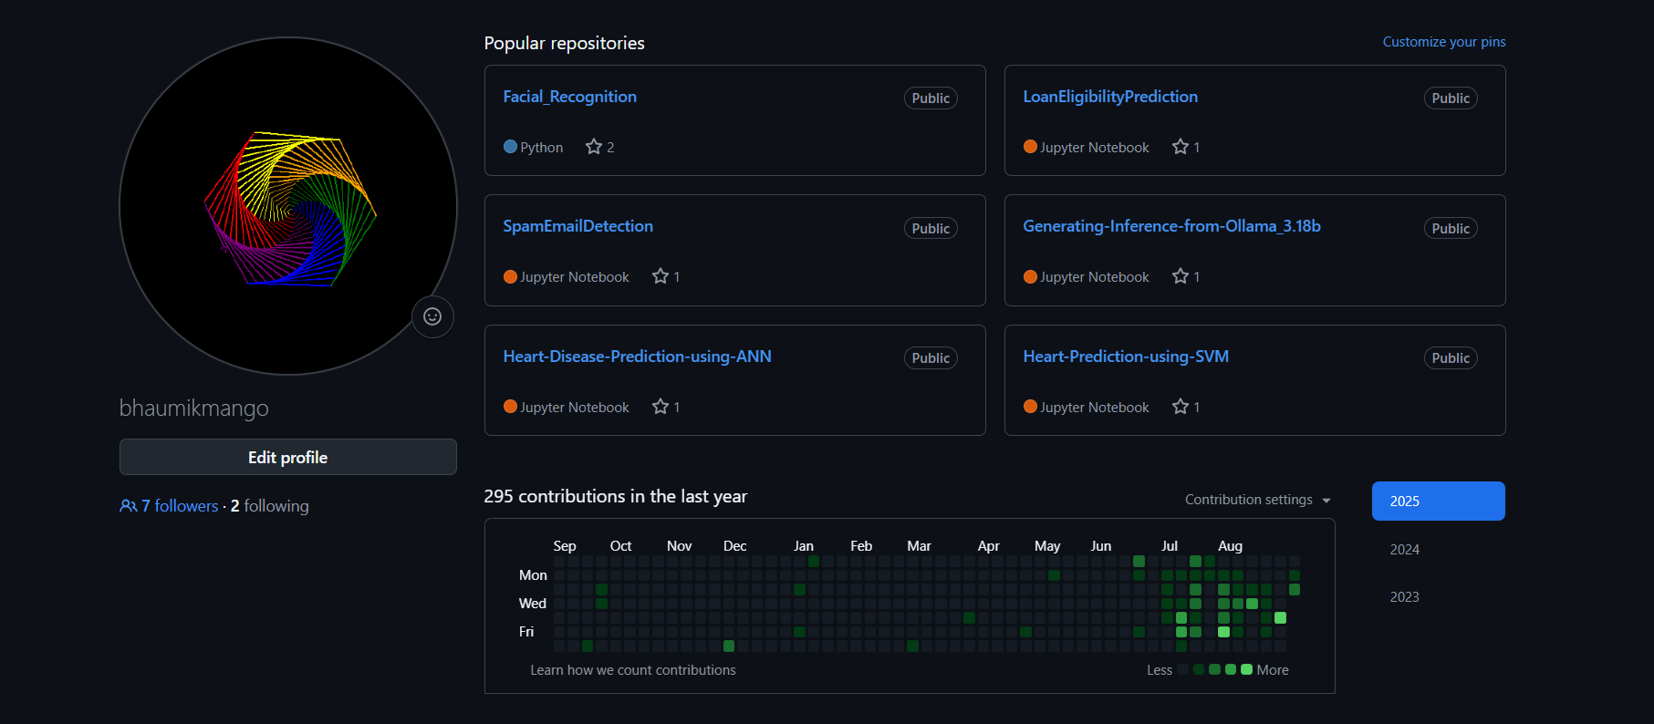
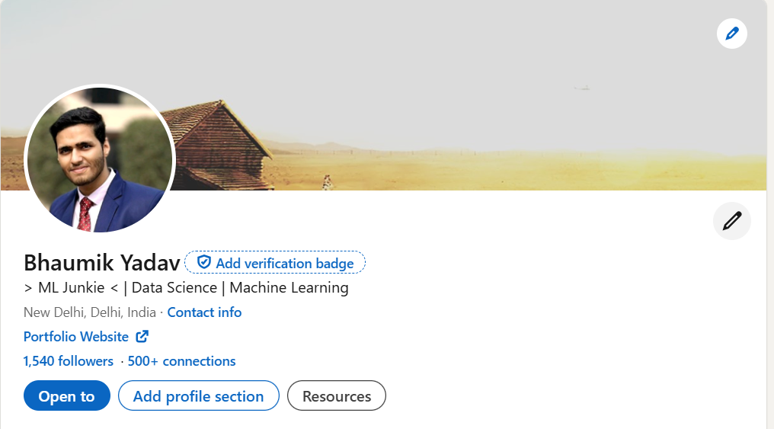
More About Me
Ex DRDO
Student Coordinator – TT
Tech Community CS & Allied
President – DataVerse Data Science Community
CS & Allied

Slide 4

AGENDA
Revision to previous concepts
Intro to Logistic Regression
Project ✨
Q/A

Slide 5


Join the WhatsApp group for all updates:

Slide 6
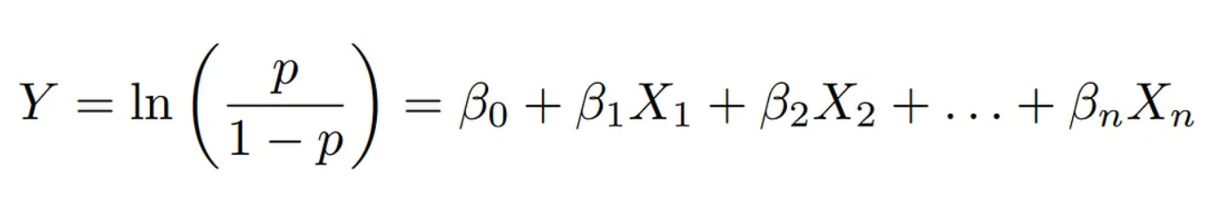
Logistic Regression
Logistic Regression is a fundamental supervised machine learning algorithm used for classification tasks, where the output variable is categorical (for example, predicting whether an employee will leave or stay, 0 or 1). Unlike Linear Regression, which predicts continuous values, Logistic Regression predicts probabilities using the sigmoid (logistic) function, which maps any real number to a range between 0 and 1.
The logistic function is given by:
Here, β0,β1,...,βn​ are model parameters (coefficients), and X1,X2,...,Xn are the input features.
If the probability P(Y=1∣X) or Y is greater than 0.5, the model classifies the outcome as 1 (Yes); otherwise, as 0 (No).

Slide 7
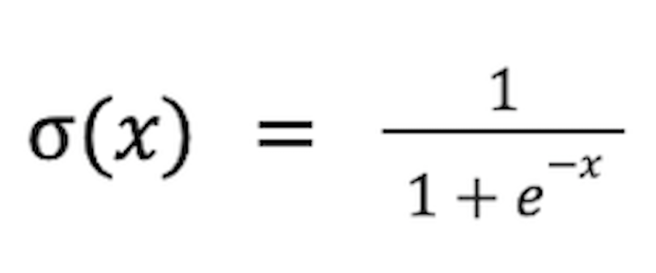
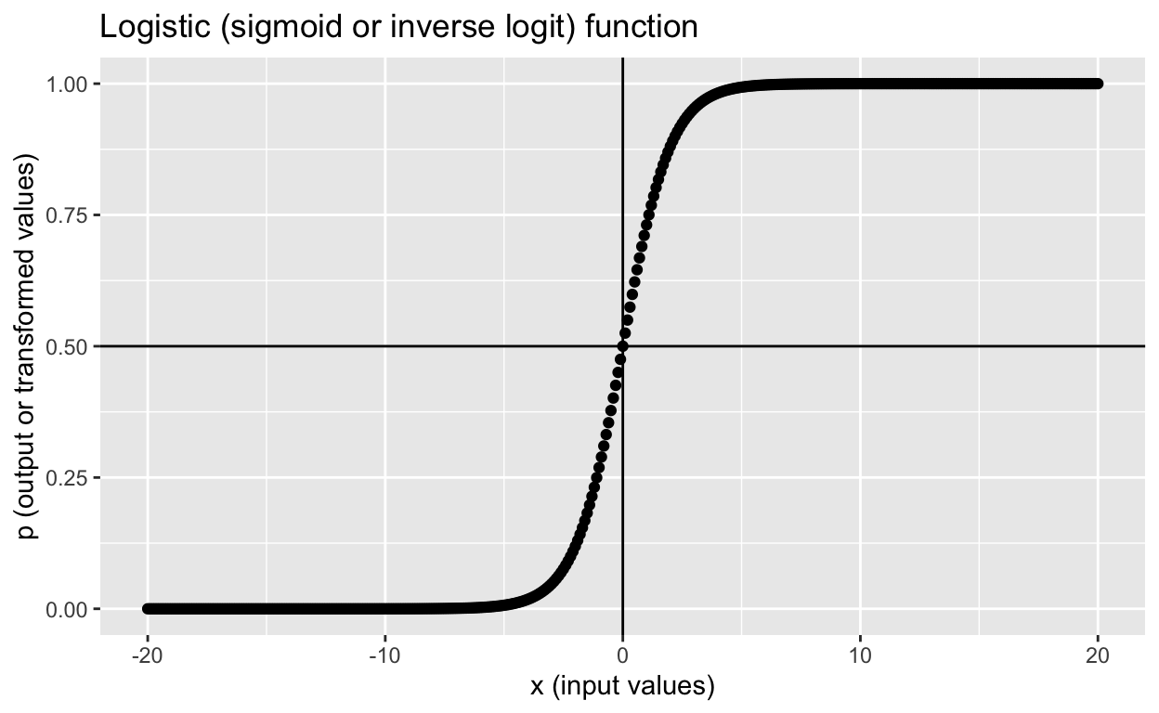
Logistic Regression
The simplified Sigmoid function expression is :
The goal of training is to find the best coefficients by minimizing the log loss (cross-entropy loss), ensuring that predicted probabilities are as close as possible to the actual class labels. Logistic Regression is widely used in applications like spam detection, disease prediction, and customer churn analysis.

Slide 8
Intro to Logistic Regression
Pre-requisites:
Python (Preferably 3.10 or less)
Jupyter Notebook or Google Colab
Pandas
Matplotlib
Numpy
Seaborn
SKLearn
Knowledge about sigmoid/logit function

Slide 9
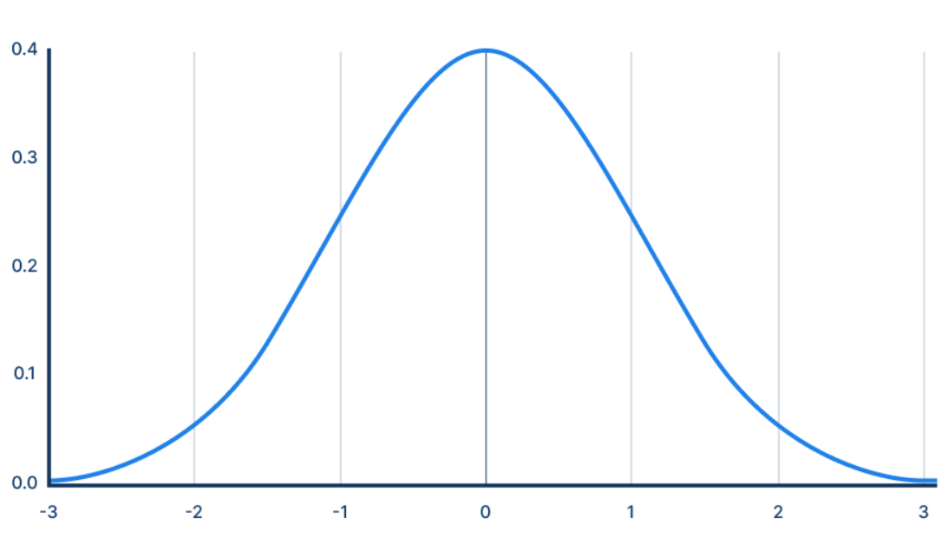
BRAIN TEASER
What is randomness?

Slide 10
Project ✨
Pre-requisites:
Python (Preferably 3.10 or less)
Jupyter Notebook or Google Colab
Pandas
Matplotlib
Numpy
Seaborn
SKLearn
Knowledge about sigmoid/logit function

Slide 11

Your Focus Areas
Mathematics (Stats*)
Critical Thinking
Logical Aptitude
Analytics
Communication
Machine Learning

Slide 12


If I was good today
Link with me on LinkedIn :

Slide 13


CONTACT DETAILS
Instagram
DataVerse :

Slide 14

THANK YOU!
Eagerly waiting for new data junkies to join us!

